Slide 1
Advanced Javascript
Specialization
.Net 4.5.1 , C# 5 ,F# 3.0
WPF 4.5 , LightSwitch
Linq 4.5 & ADO.Net EF 6.0
WCF 4.5 with REST
WF 4.5 with App. Fabric
Silverlight 5.0 with MVVM
ASP.Net 4.5.1 , IIS 7/Apache
ASP.net MVC 5.0,Web API 2.0
Prism 5 with MEF
Cloud Computing (MS Azure )
UML and OOAD with MS Visio
Adv. Java script, Jquery,
Angular JS, Ext JS 5, KO,
Dust JS, Backbone jS, RX JS
Ember JS, Node JS, MongoDB
65 Design Patterns
HTML 5, CSS 3, Qunit, Nunit
Microsoft Dynamics CRM 2013
D.S.R.Murthy M.Tech (IT)
Software Architect & Corporate Trainer
Experience : 24 years
Corporate companies Trained
Infosys, Wipro, Polaris, Infotek, IBM. Accenture. Logica , GE Energy, ADP, Verizon, HCL, JDA, Alstom,ShipNet, SumTotal, Satyam, Kanbay, EMC2, RSA, Atherstone, IGate, Cognizant, CSC, AMI, L&T, PreludeSys, ZEISys, Bluestar , Wells Fargo, Fedility, Capital IQ, Logica CMG, Tanla Solutions , GRO, SLK Software , City Group, Tesco , CFCI, Bank of America, , Hitachi, Histogenetics , ISoft, Tata AIG , Society General , ConvertTeam, GSS America, FIS , Templeton, FDS,CMC, JDA, Atlanta Sierra , Honeywell,
Liquid Hub. Mindtree, G.E.Energy, Broadridge India, Worldwide Solutions, Thomson Reuters (HP), HSBC, Fujitsu, Take Solutions, Delloite,Genisys, AIS Info. Service, IVY infotech.Trainz, Sapient, Genpact, Happiest Minds,……

Slide 2
Javascript
Javascript is world-class, dynamic, object-oriented language with super-fast implementations on the client and server sides.
Engines like Google V8, JavaScriptCore, SpiderMonkey, Rhino, and Carakan and emergent standards and technologies (with CommonJS and Node JS) make it usable both in browsers and as stand-alone, powerful architectures on the server.

Slide 3
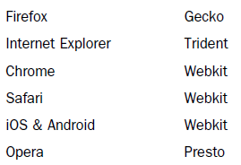
Javascript and Rendering Engines

Slide 4
Primitive types
Built-in Types
• null
• undefined
• boolean
• number
• string
• object
All of these types except object are called “primitives.”

Slide 5
Variables
Variables in JavaScript can hold values, objects, or even functions.
var a = 42;
typeof a; // "number"
Variables types :
Local variables defined within the function and accessible within the function.
function show(){
var x=10; // local variable
alert(x);
}
alert(x);// error

Slide 6
Variables
Global variables are used globally throughout JavaScript and by default attached to window object
Global variables defined in three different ways:
Defining them with “ var ” outside a function
Adding something directly to the window object
Defining them anywhere without using “ var ”
/* with var outside a function */
var titleOfApplication;
/* attached to the window object */
window.titleOfApplication
/* global from inside a function */
titleOfApplication; // observe no var keyword
Grouping variables:
var name= “Murthy",
sal = 5000, job = “Eng";

Slide 7
undefined
Undefined means object does not exist in the memory for current context. (unknown object)
null means object is created but does not hold any reference. (No value)
var emp = [ "Murthy", "Kavitha", "Pranav", "Sruthi"];
alert("emp is of type :"+ typeof (emp));// output is object
alert("book is of type " + typeof (book));// undefined
var bank=null;
alert(“bank is " + typeof (bank)+" data :"+ bank);
// bank is object data :null

Slide 8
Java script Primitive Types
undefined Versus “undeclared”
Variables that have no value currently actually have the undefined value.
Calling typeof against such variables will return "undefined":
var a;
typeof a; // "undefined"
var b = 42;
var c;
// later
b = c;
typeof b; // "undefined"
typeof c; // "undefined"

Slide 9
Java script Primitive Types
undefined Versus “undeclared”
An “undefined” variable is one that has been declared in the accessible scope, but at the moment has no other value in it.
“undeclared” variable is one that has not been formally declared in the accessible scope.
Consider:
var a;
a; // undefined
b; // ReferenceError: b is not defined
undefined is a value that a declared variable can hold. “Undeclared” means a variable has never been declared.

Slide 10
null vs undefined
• null is an empty value.
• undefined is a missing value or unknown value.
Or:
• undefined hasn’t had a value yet.
• null had a value and doesn’t anymore.
function foo() {
undefined = 2; // really bad idea!
}
function foo() {
"use strict";
undefined = 2; // TypeError!
}

Slide 11
Number
Numeric Syntax
Number literals are expressed in JavaScript generally as base-10 decimal literals. For example:
var a = 42;
var b = 42.3;
var a = 42.59;
a.toFixed( 0 ); // "43"
a.toFixed( 1 ); // "42.6“
Number.isInteger( 42 ); // true
Number.isInteger( 42.000 ); // true
Number.isInteger( 42.3 ); // false
var a = 2 / "foo";
isNaN( a ); // true

Slide 12
String
Strings
Strings are arrays of characters.
var a = "foo";
var b = ["f","o","o"];
a.length; // 3
b.length; // 3
a.indexOf( "o" ); // 1
b.indexOf( "o" ); // 1
var c = a.concat( "bar" ); // "foobar"
a === c; // false

Slide 13
Object
Everything in JavaScript is an object.
Anything can be stored in object
Functions are first class objects.
// object Literal (camel case) - global object - empInfo
empInfo = {
'name': 'Murthy',
'job': 'Engineer',
'salary': 5000,
'address': {
'hno': "2-2-223",
'city': 'hyderabad'
}
};

Slide 14
Array
Arrays
JavaScript arrays are containers for any type of value, from string to number to object to even another array .
var a = [ 1, "2", [3] ];
a.length; // 3
a[0] === 1; // true
a[2][0] === 3; // true
function foo() {
var arr = Array.prototype.slice.call( arguments );
arr.push( "bam" );
console.log( arr );
}
foo( "bar", "baz" ); // ["bar","baz","bam"]

Slide 15
JSON
var data= {
[
{“empno”:101, ”ename”:”Murthy”},
{“empno”:102, ”ename”:”Raju”},
{“empno”:103, ”ename”:”Kiran”},
{“empno”:104, ”ename”:”Rama”},
]
}
alert(data.empno + “-” +data.ename)

Slide 16
Functions

Slide 17
Functions
In javascript , function is the primary modular unit of execution.
FUNCTIONS AS FIRST-CLASS OBJECTS
Objects in JavaScript has certain capabilities:
■ can be created via literals.
■ can be assigned to variables and properties of other objects.
■ can be passed as arguments to functions.
■ can be returned as values from functions.
■ can possess properties that can be dynamically created and
assigned.

Slide 18
Function Summary
Functions are first class objects
Function can be named to access later (Hoisted)
Function can be anonymous
Function can store data called Object literal
Function can be passed as reference to another function
Function can contain inner function
Function can decide the scope
Functions are effectively used with closures
Function can be inheritable – Prototypical inheritance
Functions supports properties, methods and constructor
We can have constructor function
Functions can we invoked recursively with callee()
Functions can be bindable with existing function objects

Slide 19
Function
A function is referred to as a “callable object”—
an object that has an internal [[Call]] property that allows it to be invoked.
Functions are actually objects and can have properties. For example: length property
function a(b,c) {
/* .. */
}
a.length; // 2
Since you declared the function with two formal named parameters
(b and c), the “length of the function” is 2.

Slide 20
Function
A function is a block of code that is executed usually when invoked manually or with event.
We can pass variables into functions via arguments
to extend their functionality.
JavaScript functions have Function object
var fn = new Function (arg1, arg2, ..., argn, functionbody);
this & arguments makes function powerful
Function Overloading – Polymorphism
Functions extended with apply(), call()

Slide 21
3 Kinds of Function
1. Declarative function
A declarative function is a statement triggered by the use of the function keyword, and parsed when the JavaScript application is first loaded. - function show(){alert(“hi”)};
2. Function literal or function expression
Function can be both object and literal.
var fn= function(){alert(“hi”); fn();
It is parsed only once and it can be anonymous.
3. Function constructor or constructor function

Slide 22
3 Kinds of Function
3. Function constructor
An function constructor uses the new operator and refers the Function object.
function Gadget(name, color) {
this.name = name;
this.color = color;
this.whatAreYou = function(){
return 'I am a ' + this.color + ' ' + this.name;
}
}
var newtoy = new Gadget('webcam', 'black');
console.log(newtoy.name); //"webcam"
console.log(newtoy.color); //"black"
console.log(newtoy.whatAreYou()) ;

Slide 23
Scope
Scope is a programming concept that exists to reduce the amount of variable and function collisions in code.
It controls how far information can travel throughout JavaScript document.
The global scope for a variable means that the variable can be accessed and used anywhere in the document.
But try to keep things out of the global scope if possible
Solution : Closure

Slide 24
Scope
Private (Inner) functions
function a(param) {
function b(theinput) {
return theinput * 2;
};
return 'The result is ' + b(param);
};
a(2); // "The result is 4"
b(2); //b is not defined

Slide 25
Scope
//Inner functions via literal
var a = function(param) {
var b = function(theinput) {
return theinput * 2;
};
return 'The result is ' + b(param);
};
console.log(a(2)); // "The result is 4"
// console.log(b(2)); //b is not defined

Slide 26
Scope with Self Invoking Function - SIF
/* set up anonymous function */
(function () {
/* define a variable inside the function */
var greeting = "Hello Murthy";
/* access the variable inside the function */
alert("in scope: " + greeting);
})();
/* try and access that variable outside the function scope */
alert("out of scope: " + typeof(greeting));
// alerts "undefined"

Slide 27
Scope with Self Invoking Function - SIF
//Self Invoking Function SIF
(
function () {
alert('I am Self Invoking Function - SIF - or IIEF Immediately invoked Executing Function');
}
)()
// IIEF with parameter
(
function (name) {
alert('Hello ' + name + '!');
}
)('Murthy')

Slide 28
Closure
A closure is the scope created when a function is declared that allows the function to access and manipulate variables that are external to that function.
Closures allow a function to access all the variables, as well as other functions, that are in scope when the function itself is declared.

Slide 29
Analysing Immediately Executed Function
(function(){})()
Let us Operate the syntax:
(...)()
We know that we can call any function using the functionName() syntax, but in place of the function name we can use any expression that references a function instance.
var someFunction = function(){ ... };// Function Expression
result = someFunction();

Slide 30
Analysing Immediately Executed Function
As with other expressions, if we want an operator—in this case, the function call operator ()—to be applied to an entire expression, we’d enclose that expression in a set of parentheses.
That means that in (...)(), the first set of parentheses is merely a set of delimiters enclosing an expression, whereas the second set is an operator.

Slide 31
Analysing Immediately Executed Function
It’d be perfectly legal to change our example to the following, in which the expression that references the
function is enclosed in parentheses: eg :(4+5)*2
var someFunction = function(){ ... };
result = (someFunction)();
Now, rather than the variable name, if we directly provided the anonymous function within the first set of
parentheses, we’d end up with this syntax:
(function(){...})();

Slide 32
Analysing Immediately Executed Function
If we go ahead and provide a body for the function, the syntax expands to the following:
(function(){
statement-1;
statement-2;
statement-n;
})();
The result of this code is an expression that does all of the following in a single statement:
■ Creates a function instance
■ Executes the function
■ Discards the function
CLOSURE

Slide 33
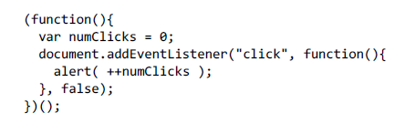
Analysing Immediately Executed Function
Temporary scope and private variables
Because the function is executed immediately, and, as with all functions, all the variables inside of it are confined to its inner scope, we can use it to create a temporary
scope, within which our state can be contained.
CLOSURE

Slide 34
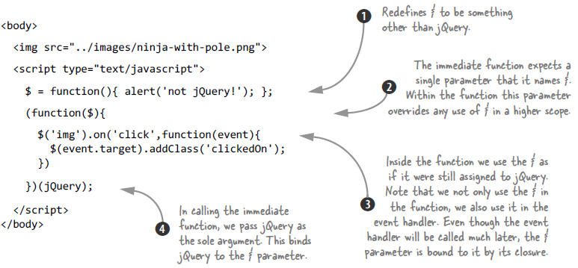
Wrapping Jquery

Slide 35
Prototypical Inheritance

Slide 36
Prototypical Inheritance
In Java /C++ / C# , Classes inherit from other classes.
In JavaScript, the inheritance is prototype-based.
That means that there are no classes. Instead, an object inherits from another object .

Slide 37
Prototypical Inheritance
In javascript every function has a prototype property, which contains an object.
When this function is invoked using the new operator, an object is created and this object has a secret link to the prototype object.
The secret link (called __proto__ in some environments) allows methods and properties of the prototype object to be used as if they belong to the newly-created object.

Slide 38
Prototypical Inheritance
The prototype object is just a regular object and therefore it also contains a link to its prototype.
And so a chain is created, called a prototype chain.
Object →null
C (_proto_)
B (_proto_)
A (_proto_)
This chain ends with the Object object, which is the highest-level parent, and every object inherits from it.

Slide 39
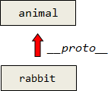
Prototypical Inheritance
Inheritance, the __proto__
When an object rabbit inherits from another object animal, in JavaScript there is a special property _proto_
rabbit.__proto__ = animal.

Slide 40
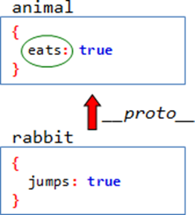
Prototypical Inheritance
When a rabbit property is accessed, and the interpreter can’t find it in rabbit, it follows the __proto__ link and searches in animal.
var animal = { eats: true }
var rabbit = { jumps: true }
rabbit.__proto__ = animal // inherit
alert(rabbit.eats) // true

Slide 41
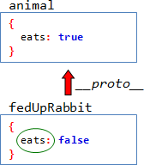
Prototypical Inheritance
If the property is found in rabbit,
then __proto__ is not checked.
The rabbit.eat() is executed in two steps:
First, the interpreter looks up rabbit.eat. There’s no eat in rabbit object, so it goes to rabbit.__proto__ and finds it there.
The function runs with this = rabbit

Slide 42
Prototypical Inheritance
var animal = {
eat: function() {
alert( "I'm full" )
this.full = true
}
}
var rabbit = {
jump: function() { /* something */ }
}
rabbit.__proto__ = animal;
rabbit.eat()

Slide 43
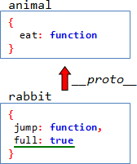
Prototypical Inheritance
The value of this is completely irrelevant to __proto__. It is set exactly to the object before the dot
So, this.full = true stores the value in the rabbit object:

Slide 44
Prototypical Inheritance
An object calls parent method, but this is set to the object itself. That’s the inheritance.
The object, referenced by __proto__ is called a prototype.
So, animal is a prototype of rabbit

Slide 45
Prototypical Inheritance
Object.create, Object.getPrototypeOf
The __proto__ is a non-standard property, provided by Firefox/Chrome.
In other browsers the property still exists internally, but it is hidden.
All modern browsers except Opera (IE from 9) support standard methods for working with prototypes:
Object.create(proto[, props])
Creates an empty object with given __proto__:

Slide 46
Prototypical Inheritance
// IE 9 cross browser
var animal = { eats: true }
rabbit = Object.create(animal)
rabbit.jumps = true;
// add properties to it once created
alert(rabbit.eats) // true

Slide 47
Prototypical Inheritance
Object.getPrototypeOf(obj)
Returns the value of obj.__proto__.
The method is standard, so it works in browsers which don’t support __proto__ property:
var animal = {
eats: true
}
rabbit = Object.create(animal);
alert(Object.getPrototypeOf(rabbit) === animal)
// true

Slide 48
Prototypical Inheritance
The prototype
There is a good and cross browser way of setting __proto__.
It requires the use of constructor functions ( use new)
function Rabbit(name) {
this.name = name
}
var rab = new Rabbit('Murthy');
alert(rab.name) ;
// A new function call sets the __proto__ of the object to the value of its prototype property.

Slide 49
Prototypical Inheritance
var animal = { eats: true };
function Rabbit(name) {
this.name = name;
}
Rabbit.prototype = animal ;
//The code Rabbit.prototype = animal
//means the following:
// ”set __proto__ = animal for all objects created by new Rabbit”
var rabbit = new Rabbit('Murthy')
alert( rabbit.eats )
// true, because rabbit.__proto__ == animal
alert(rabbit.hasOwnProperty('eats')); // false

Slide 50
Prototypical Inheritance
Extending Natives
Native JavaScript objects store their methods in prototypes.
For example, When a new object is created, it doesn’t have anything. Then how would toString work?
var obj = { }
alert( obj.toString() )
That’s because obj = {} is a short for obj = new Object, where Object is a native JavaScript constructor function.
And the object, made by new Object naturally receives object.__proto__ == Object.prototype, where Object.prototype is a native object with Object.prototype.toString

Slide 51
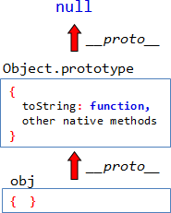
Prototypical Inheritance
When an object property is accessed, the interpreter searches it:
In the object itself,
Then in it’s __proto__,
Then in it’s __proto__.__proto__ etc.
The chain is followed until the property is found or the next __proto__ == null.
So, all properties of Object.prototype become available in objects. That’s why all objects have toString().
Same story with Array, Function and other objects. Their methods are in Array.prototype, Function.prototype etc.

Slide 52
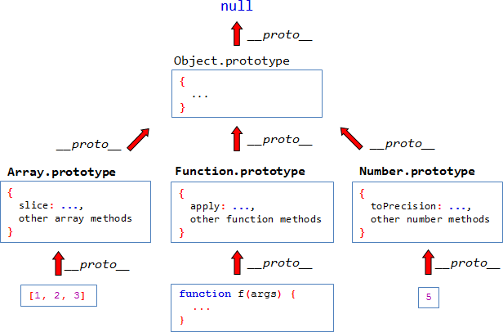
Prototypical Inheritance

Slide 53
Prototypical Inheritance
// constructor
function MyArray() {
this.stringify = function() {
return this.join(', ')
}
}
// Make sure that (new MyArray) has the right __proto__
MyArray.prototype = Array.prototype
// Test
var myArr = new MyArray()
myArr.push(1)
myArr.push(2)
alert( myArr.stringify() ) // 1, 2
alert( myArr.length) // 2 in all except IE
Extending Natives

Slide 54
Prototypical Inheritance
When you declare a function
function Rabbit() { /* ..code.. */ }
The interpreter creates the new function object from declaration. Together with the function, it’s prototype property is created and populated.
This default value the prototype is an object with property constructor, which is set to the function itself.
Rabbit.prototype = { constructor: Rabbit }
Constructor

Slide 55
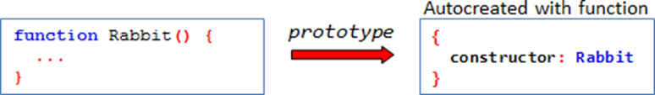
Prototypical Inheritance
Constructor
So, when new Rabbit is called, the Rabbit.prototype becomes __proto__ and the constructor becomes accessible from the object:
rabbit.__proto__ == { constructor: Rabbit }
function Rabbit() { }
var rabbit = new Rabbit()
alert( rabbit.hasOwnProperty('constructor') ) // false
alert( Rabbit.prototype.hasOwnProperty('constructor') ) // true

Slide 56
Prototypical Inheritance
Pseudo Classical Pattern
function Animal(name) {
this.name = name
}
Animal.prototype = {
canWalk: true,
sit: function() {
this.canWalk = false
alert(this.name + ' sits down.')
}
}
var animal = new Animal('Pet')
alert(animal.canWalk) // true
animal.sit()
alert(animal.canWalk) // false
Methods and default properties are in prototype.
Methods in prototype use this, which is the current object because the value of this only depend on the calling context, so animal.sit() would set this to animal.

Slide 57
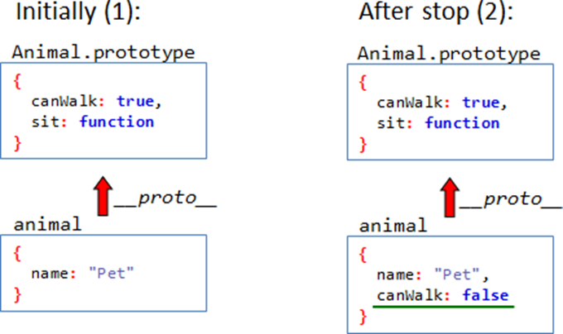
Prototypical Inheritance
Pseudo Classical Pattern

Slide 58
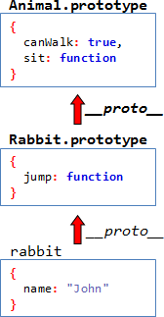
Prototypical Inheritance
Pseudo Classical Pattern
function Rabbit(name) {
this.name = name
}
Rabbit.prototype.jump = function() {
this.canWalk = true;
alert(this.name + ' jumps!') }
var rabbit = new Rabbit('Murthy');
rabbit.jump();
Murthy

Slide 59
Events

Slide 60
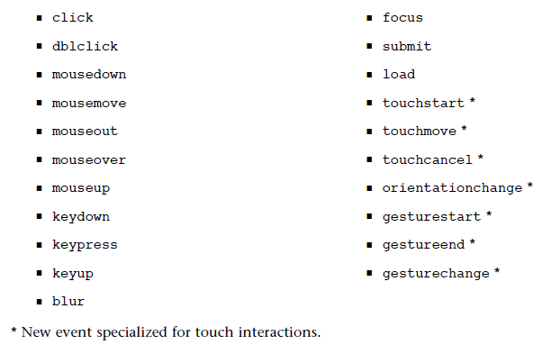
The Event
Event is happening of something so that we can action can be taken by invoking function (Eg. Click event )

Slide 61

The Event
DOM Level 2 supports AddEventListener and RemoveEventListener to register and unregister events.

Slide 62
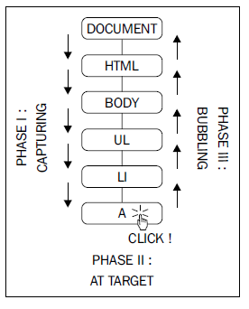
The Event
Events are captured and bubbled in DOM tree.
Event capturing—the click happens on the document first, then it propagates to the body, the list, the list item, and finally to the link.
Event bubbling—the click happens on the link and then bubbles up to the document.

Slide 63
The Event
IE and Netscape implemented the exact opposites.
IE implemented only bubbling, Netscape only capturing.
After the DOM specification, Firefox, Opera, and Safari implemented the three phases, but IE kept only the bubbling.
The third parameter (false) to addEventListener() specifies whether or not capturing should be used.
In order to have your code more portable across browsers, it is better to always set this parameter to false and code using bubbling only.

Slide 64
The Event
The delegation concept:
If there are many element inside one parent, and you want to handle events on them of them - don’t bind handlers to each element.
Instead, bind the single handler to their parent, and get the child from event.target.

Slide 65
The Event
Event Handler : document.onclick…..
Event Listener: button.addEventListener(type,callback,capture);
button.removeEventListener(…);
Event Delegation with Cross browser
Event Bubbling
Event Capture
Event Propagation

Slide 66
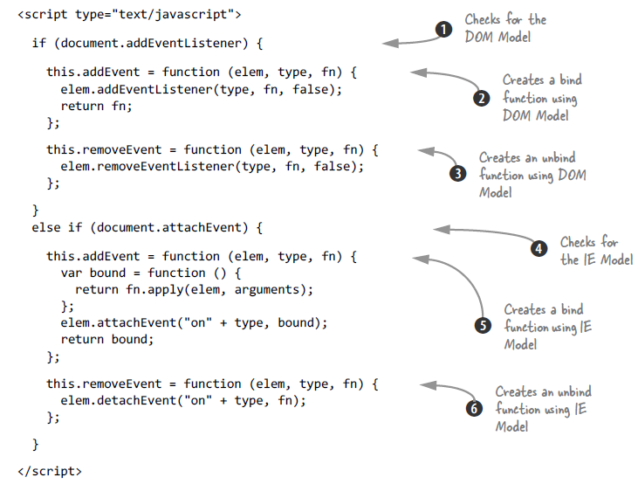
The Event – Cross Browser
Providing proper context when binding event handlers

Slide 67
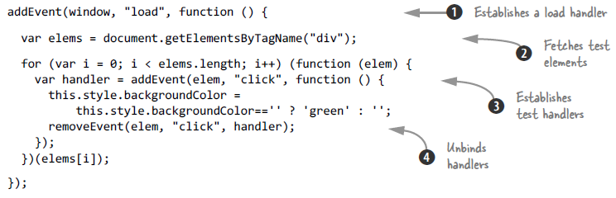
The Event – Cross Browser
Testing the Event Binding API

Slide 68

Events – Event Driven Javascript
Events are triggered in the browser when something happens.
There are predefined events like load , click …
We can create custom events in java script
events need to be attached to DOM elements to be executed.
The statement “click a link” means that the event “click” is being attached to a “link,” and then a function is executed.

Slide 69
Events – Event Driven Javascript
Event handlers are callback functions which contains logic .
/* wrap it in an anonymous function to contain the variables */
(function(){
// HTML: <button type="button" id="btn“ text=“click”/>
var btn = document.getElementById("btn");
// Use an event handler to attach the "onclick" event
btn.onclick = function(){
// alert inside this anonymous callback function
alert('clicked the button');
}
})();
Demo : day1 / Events/1. EventHandler

Slide 70
Event Listener
With Event Listener, don’t have the limitation of the handler when assigning multiple functions to the same DOM element and event
// event listener with an anonymous function
element.addeventListener("event", function(){
// stuff you want the function to do
}, false);
Arguments for addeventListner
DOM element, 2. Eventname 3. callback
4. Boolean to initiate capture
Demo : day1 / Events/2. EventListener

Slide 71
IE Fallback Code for Listeners
var btn = document.getElementById("btn");
if(btn.addEventListener){
/* if eventListener is supported do this */
btn.addEventListener("click", function(){
alert("clicked the button");
}, false);
}
else
{
/* if it's not supported do this (for IE8 and below) */
element.attachEvent("click", function(){
alert("Clicked the button");
});
}

Slide 72
Bind Events
Parentheses in event handler mean “call this now” and we don’t want to do that in a listener, you leave them
off.
Below code use a predefined function as a listener by dropping the parentheses off.
If the parentheses were to be left on, the function would execute immediately on load of the page, even if it’s inside the addEventListener() method.

Slide 73
Bind Events
// save the DOM element you want to attach an event to
var btn = document.getElementByID("btn");
// define your function normally
function alertMessage(){
alert("clicked the button");
}
// or use a predefined function (event handler),
// "alertMessage“
btn.addEventListener("click", alertMessage, false);

Slide 74
Calling Listener with arguments
var btn = document.getElementByID("btn");
function alertMessage(message) {
alert(message);
}
btn.addEventListener("click", function() {
// callback function!
alertMessage("clicked the button");
}, false);

Slide 75
Calling Listener with arguments
Just like we bind (attach) events to DOM elements, we can unbind (detach) events from DOM nodes.
if(btn.removeEventListener){
// if removeEventListener is supported
btn.removeEventListener("click", alertMessage, false);
} else {
// if removeEventListener isn't supported (IE8 and below)
btn.detachEvent("click", alertMessage);
}
Demo: Day1/ Events/EventListener

Slide 76
Regular Expressions

Slide 77
Regular Expressions
Regular expression is a powerful way of string search and replace.
In JavaScript, it is integrated in String methods search, match and replace.
Regexp consists of a pattern and optional flags.
A basic regexp search is same as a substring search. The regexp object is created as a string surrounded by slashes "/“
regexp = /att/
str = "Show me the pattern!“
alert(“att is at “+ str.search(regexp) ) // 13

Slide 78
Regular Expressions
\d
A digit, any character from 0 to 9
\s
A whitespace character, like tab, newline etc.
\w
A symbol of Latin alphabet or a digit or an underscore '_‘
A regexp may contain many together regular symbols and character classes:

Slide 79

Regular Expressions
showMatch( "I'm 1 year old", /\d\s\w\w\w\w/ ) // 1 year
\D
A non-digit, the inversion of \d
\S
A non-whitespace, the inversion of \s.
\W
A symbol which is neither from Latin alphabet, nor a digit, nor an underscore, the inversion of \w
showMatch( "I'm 1 year old", /\W/ )
// matches apostrophe

Slide 80
Regular Expressions
Special characters
There are characters which have special use in regexps:
[ \ ^ $ . | ? * + ( ).
They are special, because they are used to enhance regexp searching abilities.
To use a special character as a regular symbol, it must be escaped. Or, in other words, prepended with a backslash.
For example, we need to find the dot '.'. In a regexp, it is a special symbol meaning any character excepts a newline.

Slide 81
Regular Expressions
showMatch( "Chapter 5.1", /\d\.\d/ ) // 5.1
Flags
A regular expression may have optional flags, which affect the search. In JavaScript, there are three flags:
g : Find all matches.
i : Case-insensitive search
m : Enable multiline mode.
A flag is appended after the pattern, like /.../g.
A regexp without global flag returns only first match:
alert( "123".match( /\d/ )) ;// ‘1’
alert( "123".match( /\d/g )) ; //’1’ , ‘2’, ‘3’

Slide 82
Regular Expressions
Multiple flags are possible. For example, find all matches and ignore the case
alert( "Smile a smile".match( /SMILE/gi )) // 'Smile', 'smile‘
Character sets and ranges
showMatch( "The OGRE on green grass!", /gr[eao]/gi )
// "GRE", "gre", "gra“
Here, gr[eao] matches gre, not gree, because [eao] stands for only one char.

Slide 83
Regular Expressions
Square brackets can also contain character ranges. For example, [a-z] is a character from a to z, [0-5] matches a character from 0 to 5.
showMatch( "Exception 0xAF", /x[A-F]/g )
// matches "xA", not "xc“
Square brackets starting with a caret: [^...] find all characters except the given ones.
[^aeou] - any character except ‘a’,’e’,’o’,’u’
[^0-9] - any non-digit, same as \D
[^\s] - any not-a-space, same as \S

Slide 84
Regular Expressions
Numeric Quantifiers
Say, we’ve got to find a 3-digit number. With \d that’s simple:
showMatch( "I'm 100 years old", /\d\d\d/ ) ;//100
showMatch( "I'm 12345 years old", /\d{5}/ ) ; // "12345“
To find 3-5 digit numbers, specify two numbers in figure brackets: \d{3,5}
showMatch( "I'm 1234 years old", /\d{3,5}/ ) ; //1234

Slide 85
Regular Expressions
Quantifiers +, * and ?
showMatch( "number 12345", /\d+/ );
Means “Zero or one”, same as {0,1}. Makes a character optional. For example: ou?nd finds ond in second and ound in secound.
showMatch( "second", /secou?nd/ ) ; // "second“
showMatch( "secound", /secou?nd/ ) ;
// "secound", both variants match
Means “Zero or more”, same as {0,}. A character may repeat many times or not exist at all.

